Slide 1
TAS 152
LECTURE 2
TOPIC 1
CYBER SOCIETY: CORE VALUES AND VIRTUES
1.2 THE DIMENSIONS OF CYBER ETHICS

Slide 2
RECAP
What are the core values and virtues of a cyber-society?
We start by looking at cyber-space
How does cyber-space differ from physical space?
Seven key differences
Time
Space
Size
Virtual
Anonymous
Money
Power

Slide 3
THE DIMENSIONS OF CYBER ETHICS
Ethical issues can be grouped into six dimensions:
1. Life Ethics
2. Community Ethics
3. Environmental Ethics
4. Political Ethics
5. Economic Ethics
6. Cultural and Religious Ethics
These ethical issues are applicable in the physical world and cyber world
These ethical issues have been addressed more comprehensively in the physical world than in the cyber world.

Slide 4

DIMENSION 1 – LIFE ETHICS
Natural, biological human life between birth and death.
Health ethics
Bioethics
Ageing
Health care
Telemedicine

Slide 5
DIMENSION 1 – LIFE ETHICS
Examples of ethical issues
Using AI for diagnosis, prognosis and treatment recommendation https://www.aljazeera.com/features/2023/8/1/can-ai-predict-cancer
Using AI to synthesize new proteins https://www.nature.com/articles/d41586-024-00699-0
Gene-editing https://www.thelancet.com/journals/lancet/article/PIIS0140-6736(23)01084-X/fulltext

Slide 6







DIMENSION 2 – COMMUNITY ETHICS
Ethics pertaining to communities (and communication that takes places therein) in cyberspace.
Social media i.e. Instagram
Any online space that facilitates communication and fostering of a community

Slide 7
DIMENSION 2 – COMMUNITY ETHICS
Examples of ethical issues
Cyberbullying https://www.citizen.co.za/brakpan-herald/news-headlines/2024/03/09/spotlighting-cyberbullying/
Self-esteem issues in young women and girls https://www.edweek.org/leadership/the-state-of-girls-mental-health-and-self-confidence-in-charts/2023/11
Self-esteem issues in men https://www.nytimes.com/2022/03/05/style/teen-bodybuilding-bigorexia-tiktok.html

Slide 8
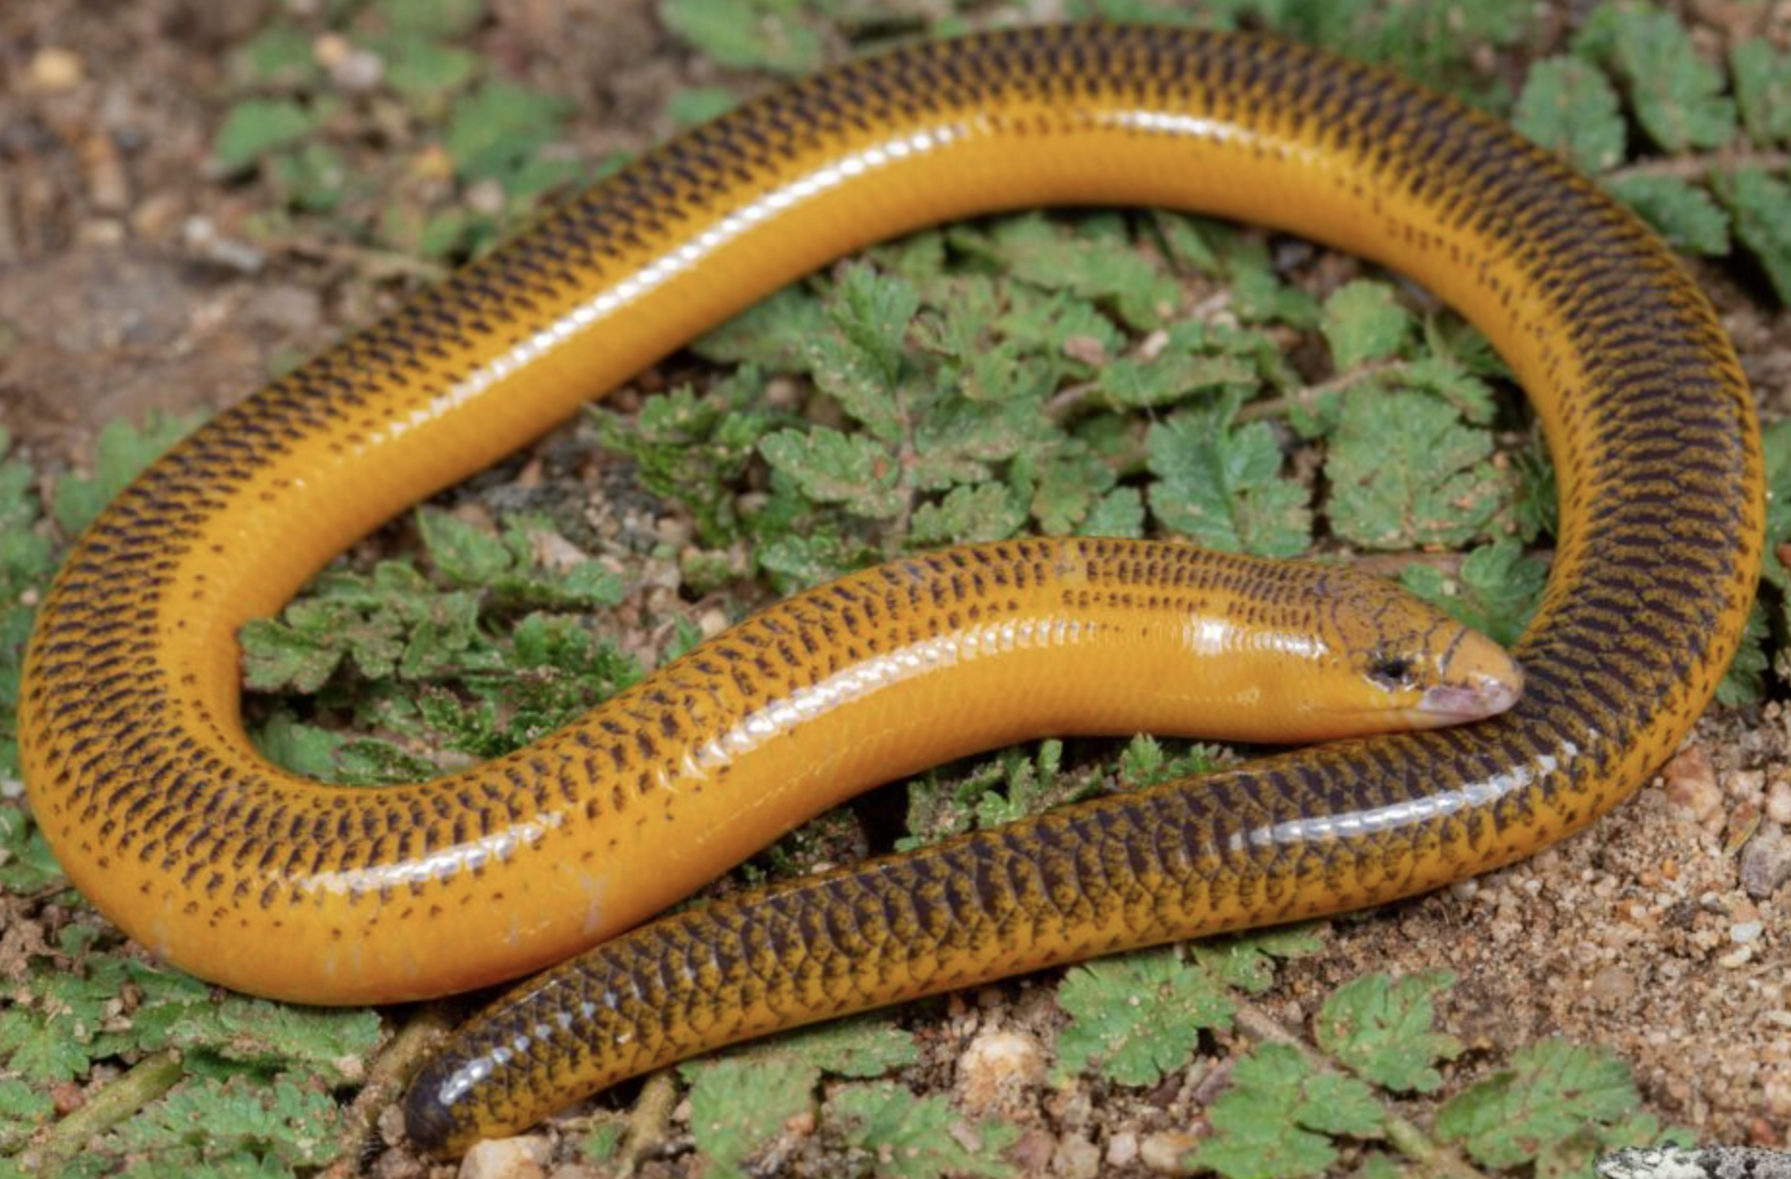
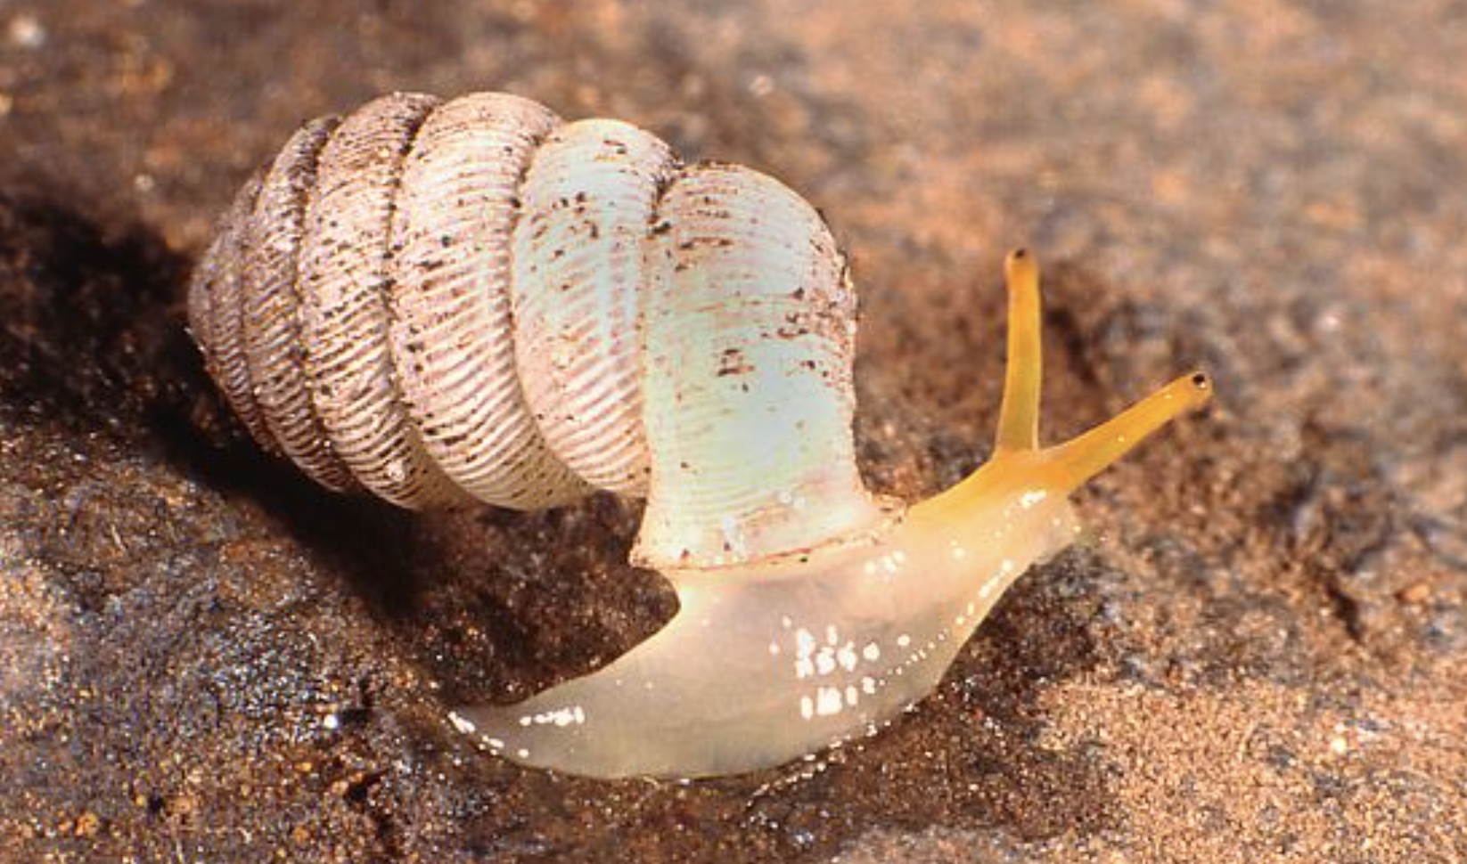
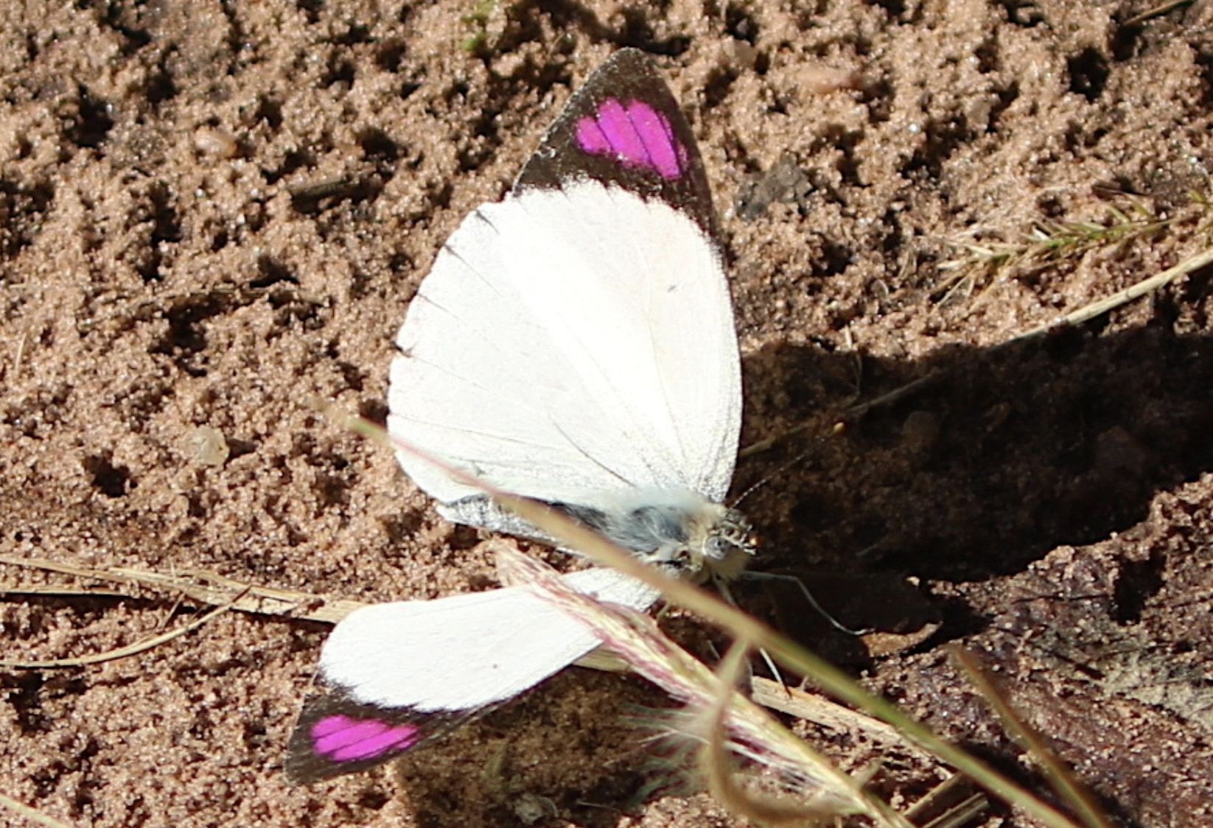
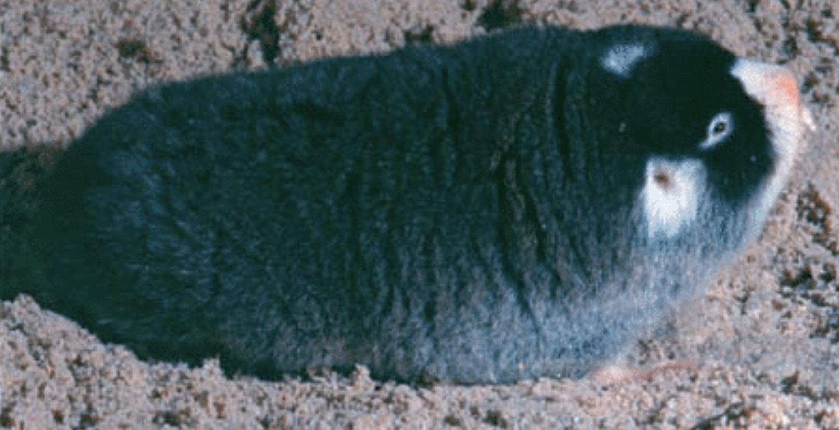
DIMENSION 3 – ENVIRONMENTAL ETHICS
Impact of technology on environmental management, energy use and environmental degradation

Slide 9
DIMENSION 3 – ENVIRONMENTAL ETHICS
Examples of ethical issues
AI tech is very very very power hungry https://www.theverge.com/24066646/ai-electricity-energy-watts-generative-consumption
Cryptocurrency (Bitcoin etc) is also very very very power hungry https://www.theverge.com/2023/11/29/23979858/bitcoin-mine-cryptocurrency-water-use-analysis-energy

Slide 10
DIMENSION 4 – POLITICAL ETHICS
This deals with changes in political systems, elections, security and military threats.

Slide 11
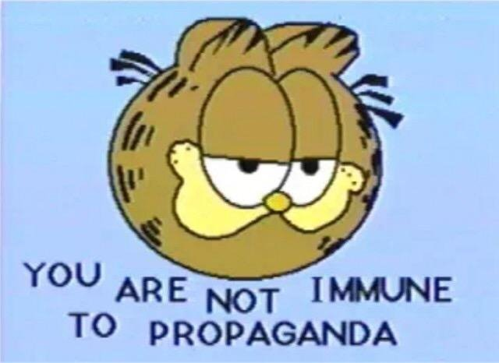
DIMENSION 4 – POLITICAL ETHICS
Examples of ethical issues
Misinformation for the sake of spreading propaganda https://www.aljazeera.com/news/2023/10/14/analysis-propaganda-deception-fake-news-and-psychological-warfare
Sensitive information being leaked https://edition.cnn.com/2024/03/04/politics/jack-teixeira-pleads-guilty/index.html

Slide 12

DIMENSION 5 – ECONOMIC ETHICS
Impact of cyberspace on
Economic growth
Job creation or job losses
Financial investments in cyber research.

Slide 13
DIMENSION 5 – ECONOMIC ETHICS
Examples of ethical issues
Glorified slave labour https://www.context.news/big-tech/gigs-scams-ghost-work-india-tech-sectors-dark-side
Irresponsibly automating jobs https://edition.cnn.com/2023/03/29/tech/chatgpt-ai-automation-jobs-impact-intl-hnk/index.html

Slide 14
DIMENSION 6 – CULTURAL AND RELIGIOUS ETHICS
Impact of cyberspace on cultural and language diversity, tolerance and attitudes towards different religions and cultures.
Encouraging education about different religions and cultures.

Slide 15
DIMENSION 6 – CULTURAL AND RELIGIOUS ETHICS
Examples of ethical issues
Inaccesibility due to language barriers https://www.technologyreview.com/2015/03/06/168966/the-online-language-barrier/
Theology and religious conversations may simply be too important for certain platforms https://blogs.lse.ac.uk/religionglobalsociety/2023/08/can-you-do-theology-on-tiktok/

